Slide 1
CO2201 Software Engineering Project
Project Software Architecture

Slide 2
Application Layer – React
React is fast and efficient, particularly for building large and complex user interfaces
Virtual DOM
Notes:
In our project, we used React for our frontend because it is generally considered to be a fast and efficient option for building large and complex user interfaces.
The major feature that make React fast and efficient in terms of its high performance and fast rendering capabilities is something called
Virtual DOM

Slide 3

Different layers of our project
1. Presentation Layer - React
2. Application Layer – Django
3. Data Layer – SQLite
4. Web Server Layer – Rest API
Notes:
I am gonna talk about the architecture of our project. So there are Presentation layer which also means the UI, then application layer, data layer, and web server layer.

Slide 4
Does the virtual DOM update every single time when a component’s state or a prop changes?
Notes:
So, does the virtual dom update every single time when a component’s state or a prop changes?

Slide 5
NO!
React processes state updates asynchronously -> trigger a separate render cycle -> multiple updates to the virtual DOM
To improve performance, React batches state updates together that occur within a single event loop cycle, and performs a single update to the virtual DOM at the end of the cycle – batching
Batching allows React to optimise the rendering process
Notes:
By default, React processes state updates asynchronously, which means that each state update can trigger a separate render cycle. This can result in multiple updates to the virtual DOM, which can be inefficient and slow.
To improve performance, React batches state updates together that occur within a single event loop cycle, and performs a single update to the virtual DOM at the end of the cycle, rather than updating the virtual DOM multiple times. This process is called batching.
Batching allows React to optimize the rendering process, by reducing the number of updates to the virtual DOM, and thereby improving performance by avoiding unnecessary updates . It is very interesting, isn’t it?

Slide 6
Data Layer – SQLite
A relational database management system
ACID (Atomicity, Consistency, Isolation, and Durability) transactions, triggers, views, and indexes
Notes:
Then we move to our data layer. The reason why we picked a SQL database rather a NoSQL database is that we are handling structure data. Therefore SQL databases are the best choice for us.
This database we adopted supports standard SQL queries and provides a wide range of features, including ACID (Atomicity, Consistency, Isolation, and Durability) transactions, triggers, views, and indexes.

Slide 7
Other technologies for building API?
GraphQL
gRPC
Notes:
GraphQL, and gRPC are also popular technologies used for building APIs, but they have different architectures and use cases compared to Rest

Slide 8
Differences between REST, GraphQL, and gRPC
 | Rest | GraphQL | gRPC
Architecture | HTTP | HTTP/2 | HTTP/2
Data Fetching | HTTP requests | GraphQL data fetching | Binary Protocol
Performance | - | Better than Rest | Better than Rest
Notes:
Performance: GraphQL and gRPC can be more efficient in terms of data fetching and network usage, as they allow for more efficient data exchange and reduced network overhead compared to REST.

Slide 9
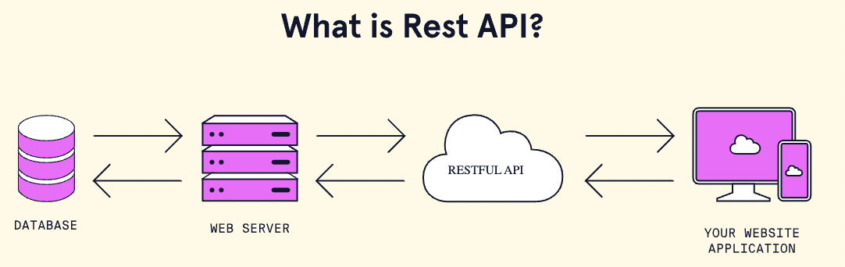
Web Server Layer – Rest API
Based on a client-server architecture that uses HTTP requests
Flexible and easy to integrate with other systems and services\
Easy to use
Notes:
REST is based on a client-server architecture that uses HTTP requests to communicate between the client and server
We chose to use REST is because its flexibility. REST APIs can support multiple data formats, including JSON, XML, and others, making them highly flexible and easy to integrate with other systems and services.
Second, it is because it’s easy to use. REST APIs are easy to learn and use due to their simple and uniform interface, making them an ideal choice for developers of all skill levels
But what are other options and why we didn’t choose them?

Slide 10

Application layer – Django
A MVC framework
High Productivity - built-in components such as ORM (Object-Relational Mapping) tool and the template engine
A wide range of built-in features - built-in features including authentication, database management, and URL routing
Scalability - features such as caching and database sharding
Security - protection against SQL injection and cross-site scripting (XSS)
Notes:
As you might know Django is a MVC framework, MVC stands for Model View Controller.
We used Django mainly because of it is designed to be scalable, with built-in support for handling high traffic and large datasets. It provides features such as caching and database sharding that can help to improve performance and scalability. That means we can easily scale up out project if there are more people using our website
Last but not least, Django provides robust security features, including protection against common web application vulnerabilities such as SQL injection and cross-site scripting (XSS)

Slide 11
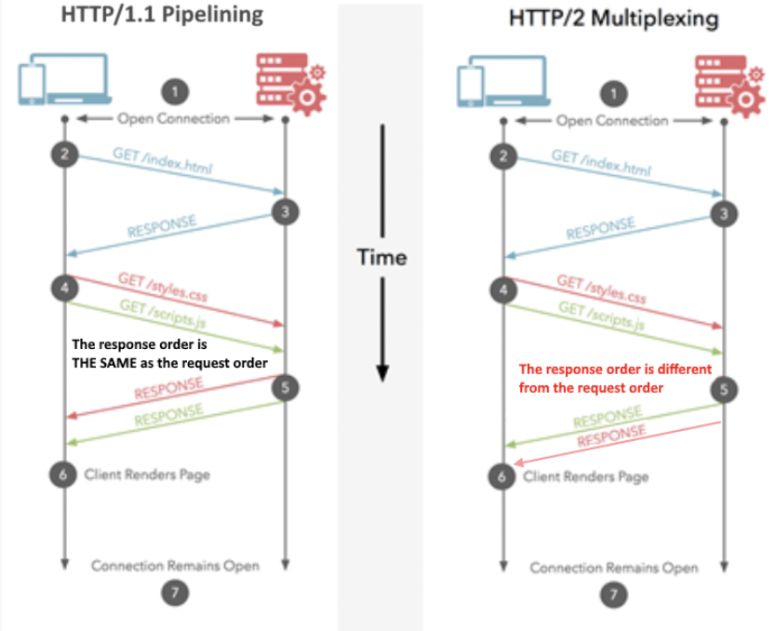
HTTP VS HTTP/2
HTTP2 – multiplexing multiple request at once on ONE TCP connection and receive requests in any order
HTTP/1.1 – pipelining receive requests in the same order they were requested
Notes:
The performance difference is mainly contributed to the protocol. Simply put, multiplexing of HTTP2 allows your Browser to fire off multiple requests at once on the same connection and receive the requests back in any order. Despite HTTP/1.1 does have the concept of pipelining which also allows multiple requests to be sent off at once. They still have to be returned in order they were requested, in their entirety, so nowhere near as good as HTTP/2, even if conceptually it's similar.
In summary, REST is suitable for simple applications that require basic data exchange, GraphQL is suitable for complex applications with a high degree of data flexibility, and gRPC is suitable for high-performance, low-latency applications that require efficient data exchange between services.
Since we were just working on a relatively small project, so we decided to use Rest to build our API. But also because of this project, we managed to know more technologies that might come in handy in the future

Slide 12
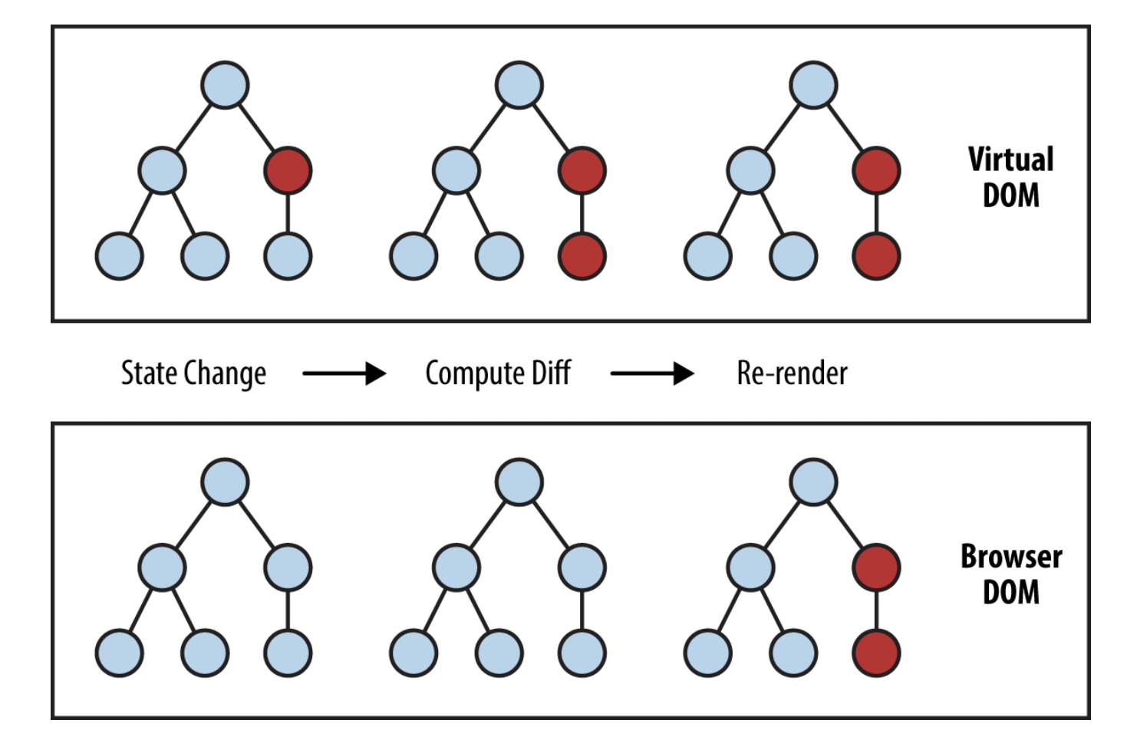
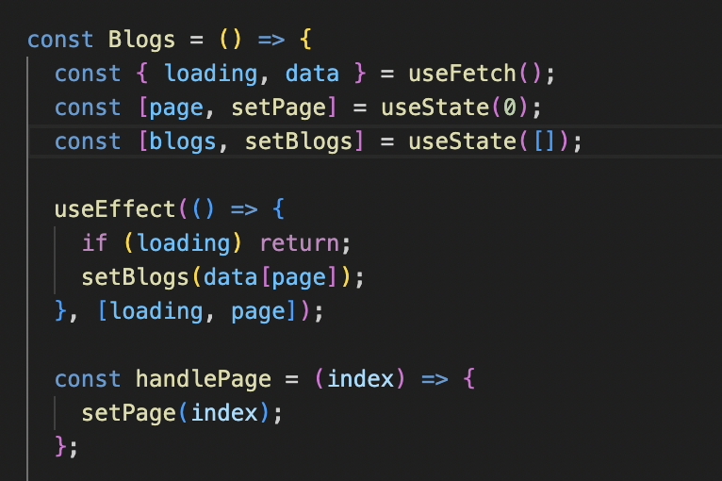
Virtual DOM (Document Object Model)
Lightweight representation of the actual DOM
Only parts of the actual DOM being updated
Improved performance and efficiency
Notes:
The Virtual DOM (Document Object Model) is a key concept in React, which is a popular JavaScript library used for building user interfaces. The virtual DOM is a lightweight representation of the actual DOM, which is a tree-like structure that represents the HTML elements on a web page.
In React, when a component's state or props change, the virtual DOM is updated with the new data, the red circles represent the nodes that have changed. These nodes represent the UI elements that have had their state changed. The difference between the previous version of the virtual DOM tree and the current virtual DOM tree is then calculated. The whole parent subtree then gets re-rendered to give the updated UI. This updated tree is then batch updated to the real DOM.
The benefits of using the virtual DOM include improved performance and efficiency, as it reduces the number of updates needed to the actual DOM. This is because updating the actual DOM can be slow and resource-intensive, particularly for complex web pages or applications.

Slide 13
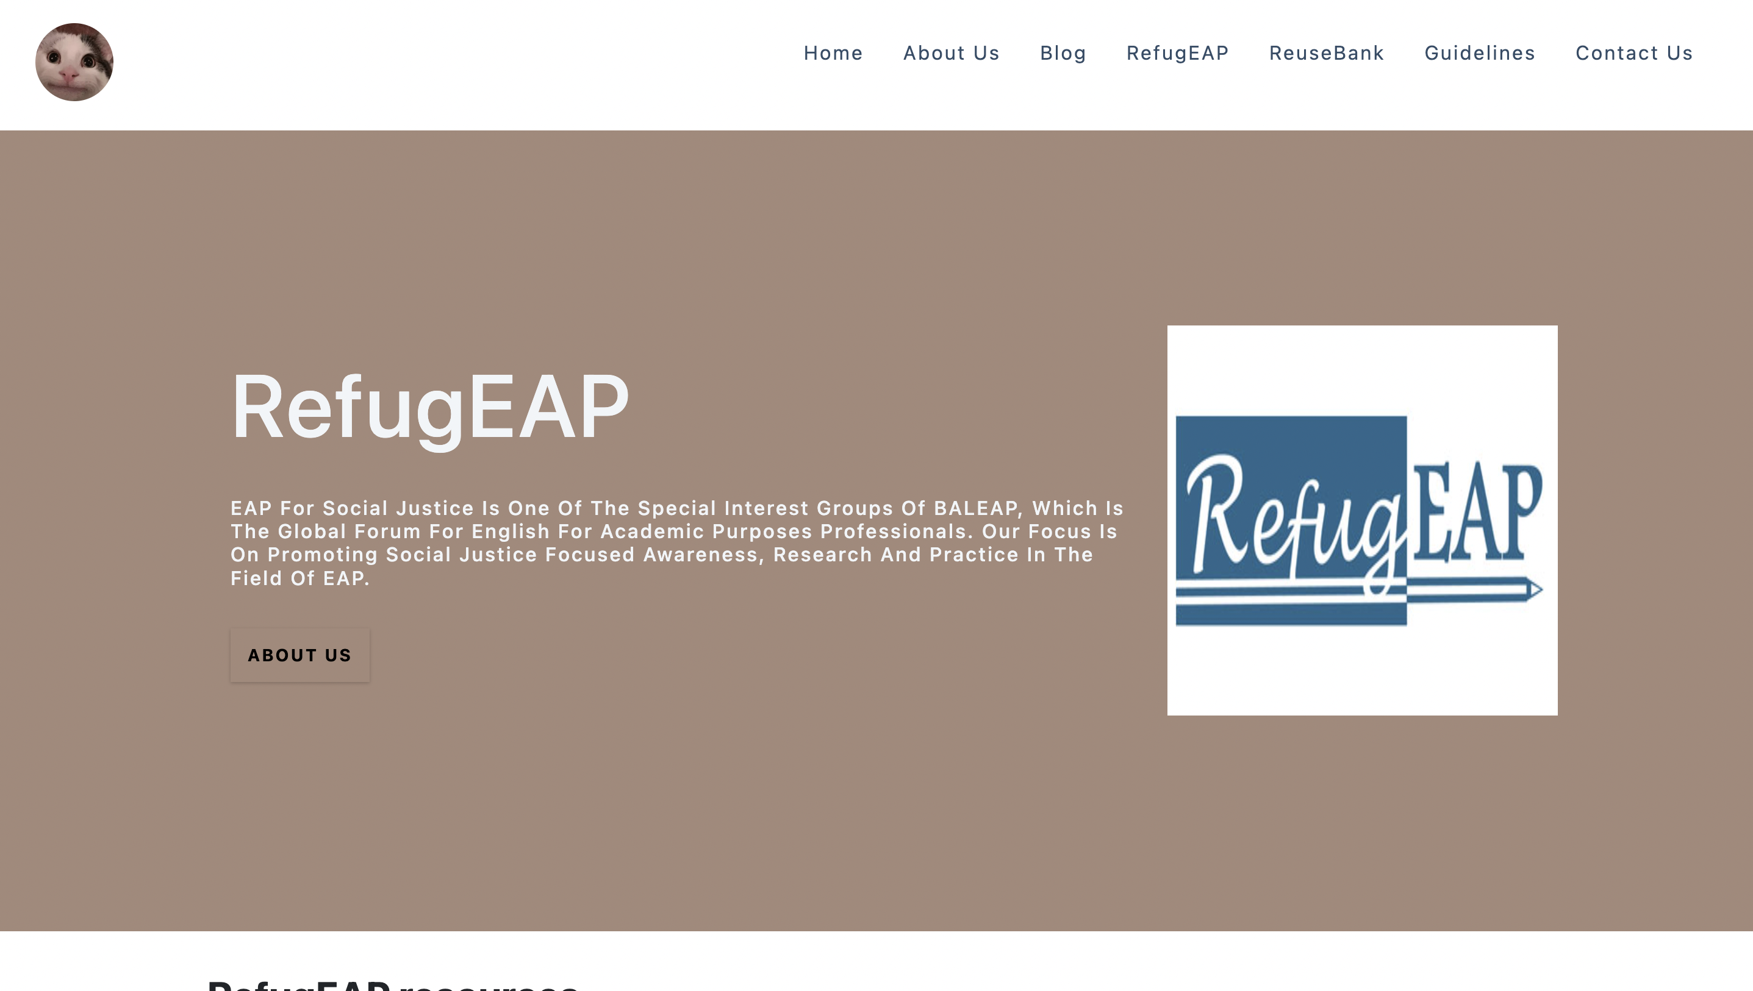
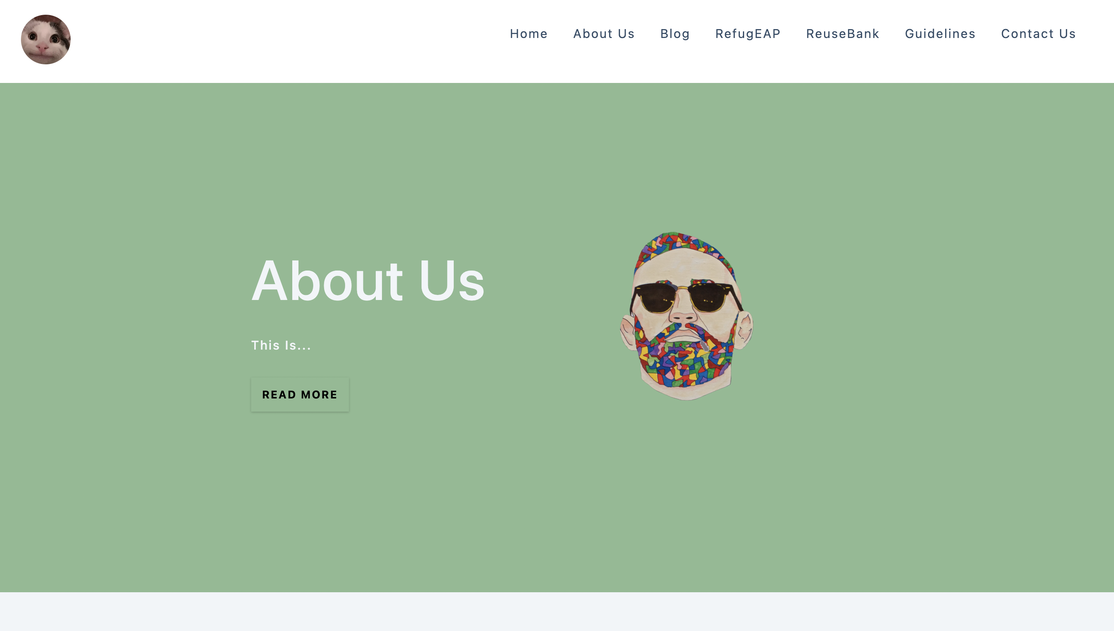
Component-based architecture
Reusable UI components
Reusable code
Consistency
Notes:
React is based on a component-based architecture, which allows developers to create reusable UI components that can be easily composed into larger applications.
This approach makes it easier to manage complexity and reuse code.
Duplicate code in a software is the last thing we want to see as a software developer
Also, it helps maintain consistency across an application as often we want the whole website to have a consistent design layout.
For example, on the right hand side, you can see our home page and about us page they both share the same layout of a hero banner.

Slide 14

Realistic plans to take RefugEAP website onward.

Slide 15

Community Building
Encouraging user engagement by creating and maintaining a sense of community on the platform.
Implementing features such as discussion forums or user-generated content sections that enable users to share their experiences, knowledge, and support.

Slide 16
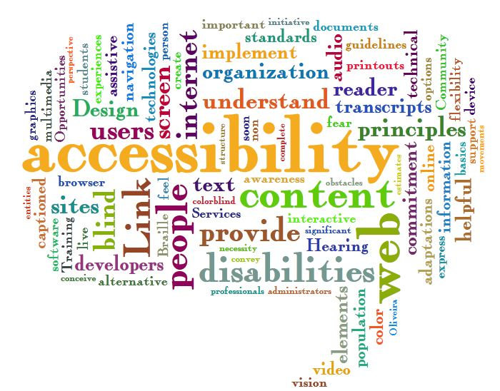
Accessibility and inclusivity
Ensuring that the website remains accessible and inclusive for all users, including those with disabilities.
Regularly check the website for compliance with accessibility guidelines and making necessary adjustments to maintain an inclusive experience for all users.

Slide 17
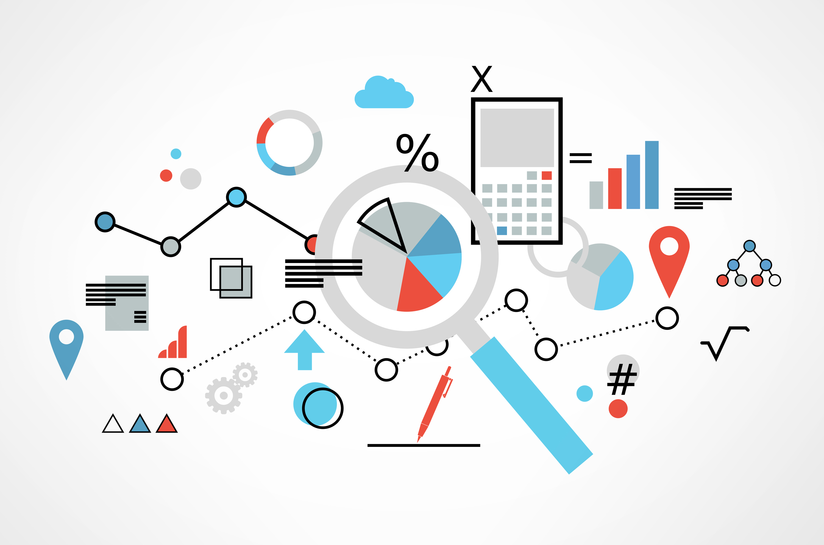
User feedback and Iterative Improvements
Collecting feedback from users to better understand what features of the interface they like, and to identify areas of improvement.
This will aid and prioritise new features and enhancements, ensuring that the website continues to meet the needs of refugees and stakeholders effectively.

Slide 18

Technical maintenance and security implementation.
Scheduling periodic maintenance to ensure the website remains secure, stable, and up-to-date with current technologies.
Implement regular security checks, updates, and backups to safeguard user data and minimize potential downtime.

Slide 19
A software design decision
Homepage links and theme

Slide 20

A snippet of the site before any design decisions were made
Lacking structure Harsh colour scheme Different fonts Unorganised
Notes:
Our problem was how we were going to present the homepage links in a neat an organised way without overcrowding the homepage as it already has a lot of information on it.
We decided to all individually come up with ideas for the site layout and theme and then hold a meeting where we combine our ideas and brainstorm together.

Slide 21


These were the homepage links we first created and were trying to transform. It was lacking and did not meet the requirements given to us by our client.
Notes:
During the last sprint after we had completed most of our user stories we realised that the site we had created was not organised and lacking structure due to the different features that were being added by a variety of people throughout the sprints. Here is an example of what it used to look like; quite tacky.

Slide 22
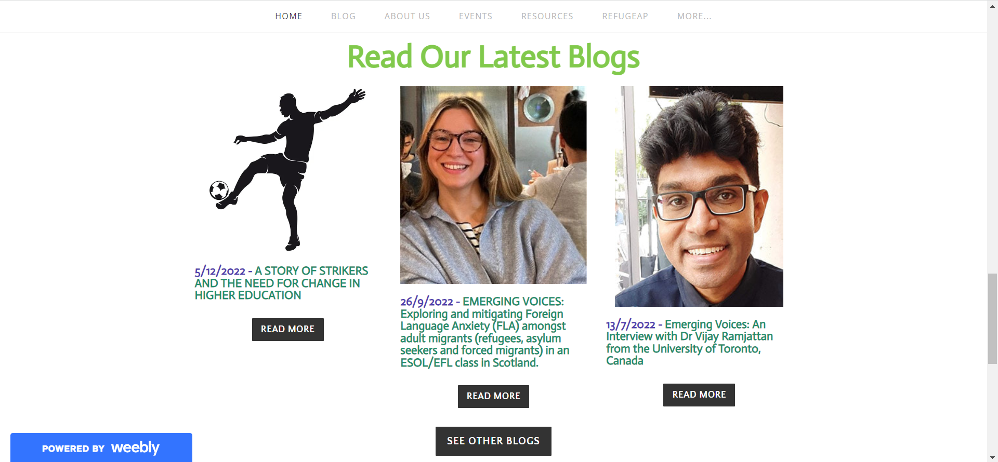
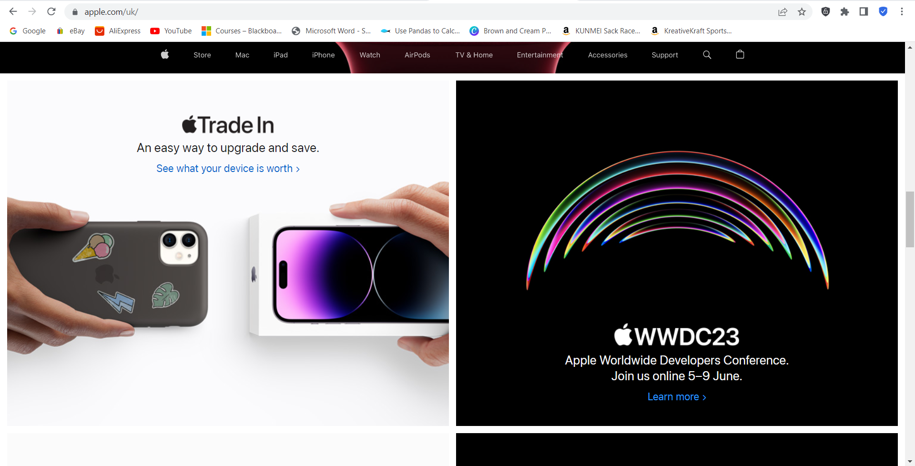
Inspiration from two sites; Apple and the official EAP website.
Notes:
We had taken inspiration from two sites, Apple and the official EAP website. We wanted to stick to what they already have as it aligned with what was requested so we didn’t want to stray too far. However, it seemed quite cluttered and we wanted a more neater aesthetic like the Apple site.

Slide 23
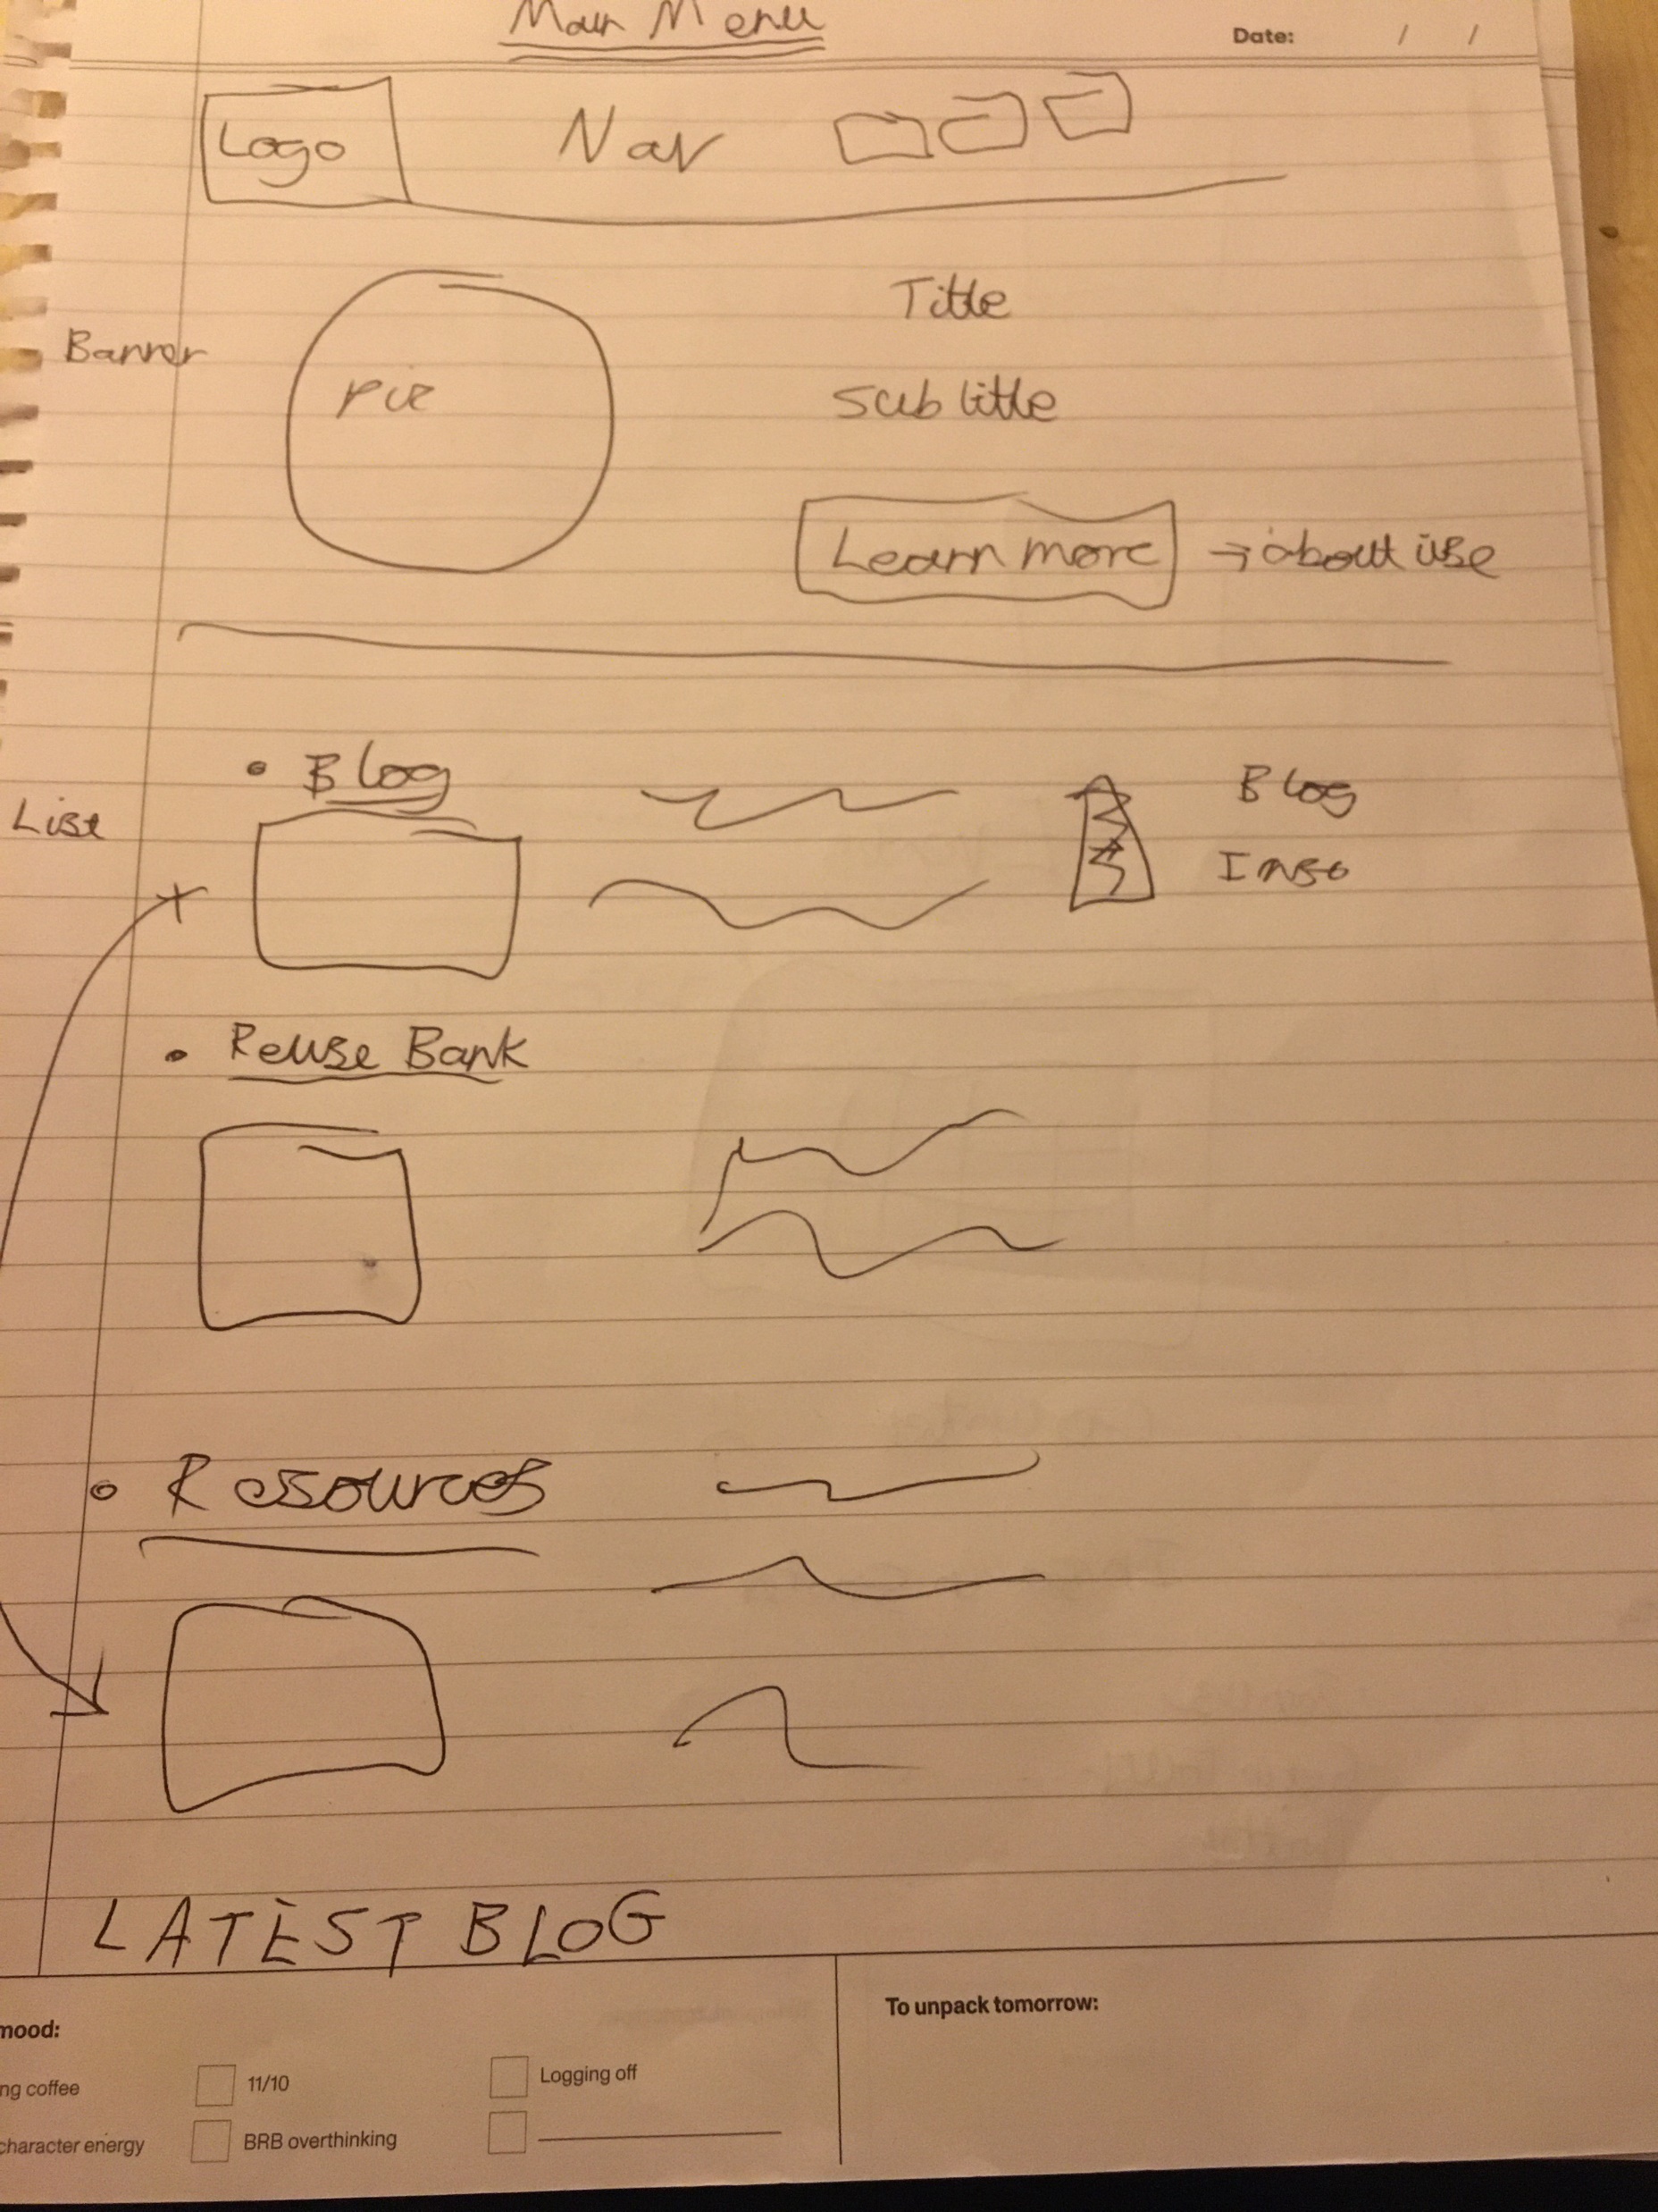
The final sketch.
Notes:
We sketched out rough designs at our held meeting of all the features we needed on the page and then we played around with the order and layout until we were all satisfied with the final result.
The final sketch has everything requested by the client and also meets our standards of what we wanted to produce.

Slide 24
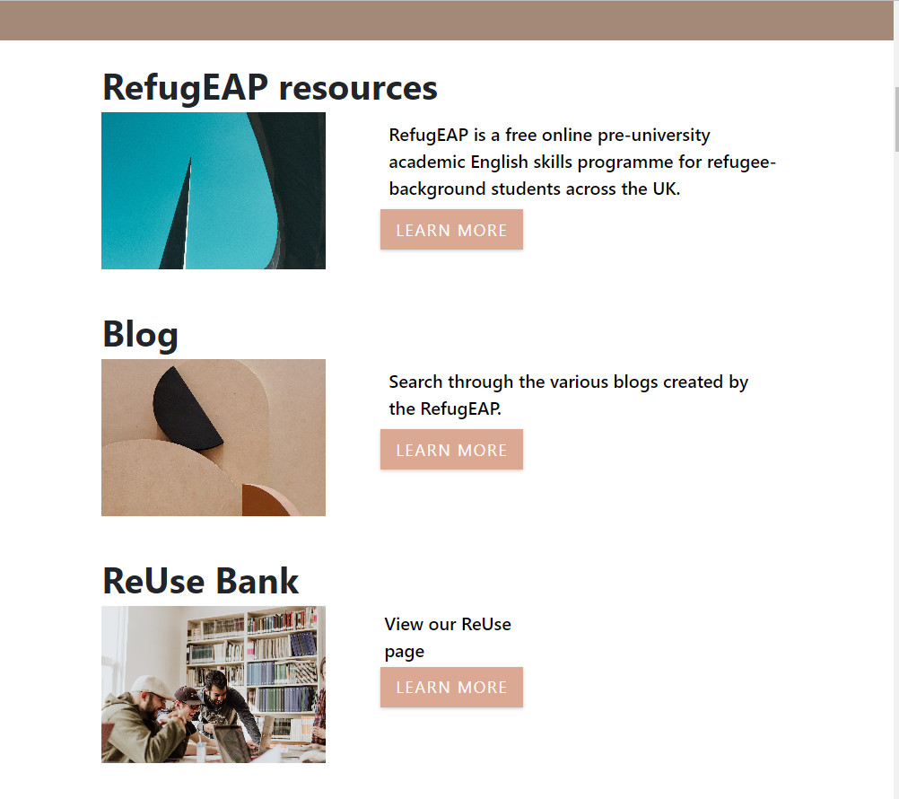
Our final homepage link design.
Notes:
This is the final design created after the sketch.

Slide 25
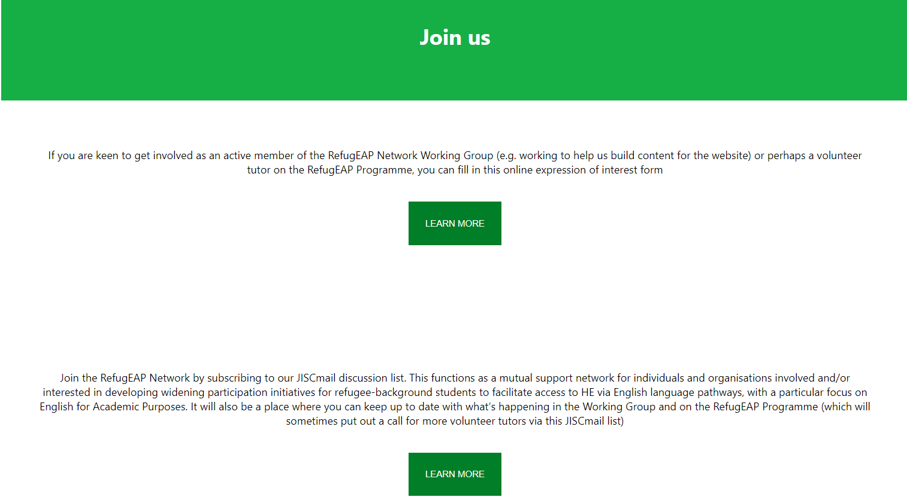
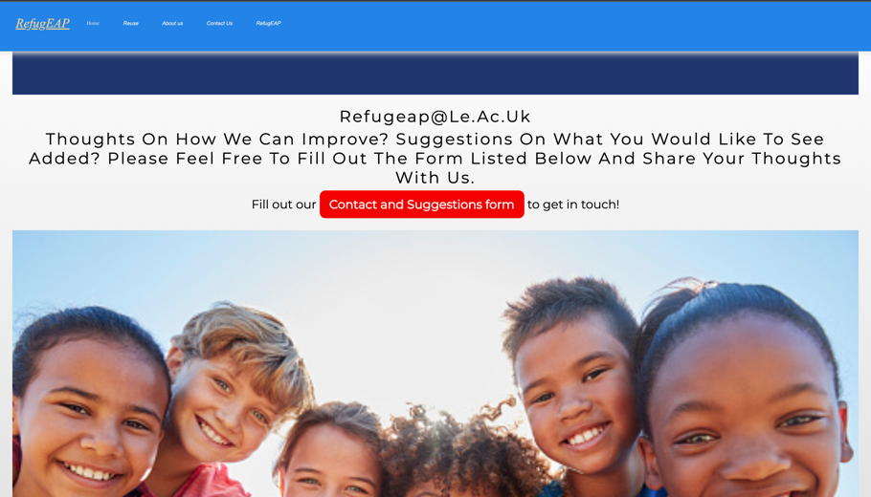
Colour scheme
Notes:
Another main issue was the colour scheme. Our site was in shambles as every page had a different theme to it and it did not look organised at all.

Slide 26
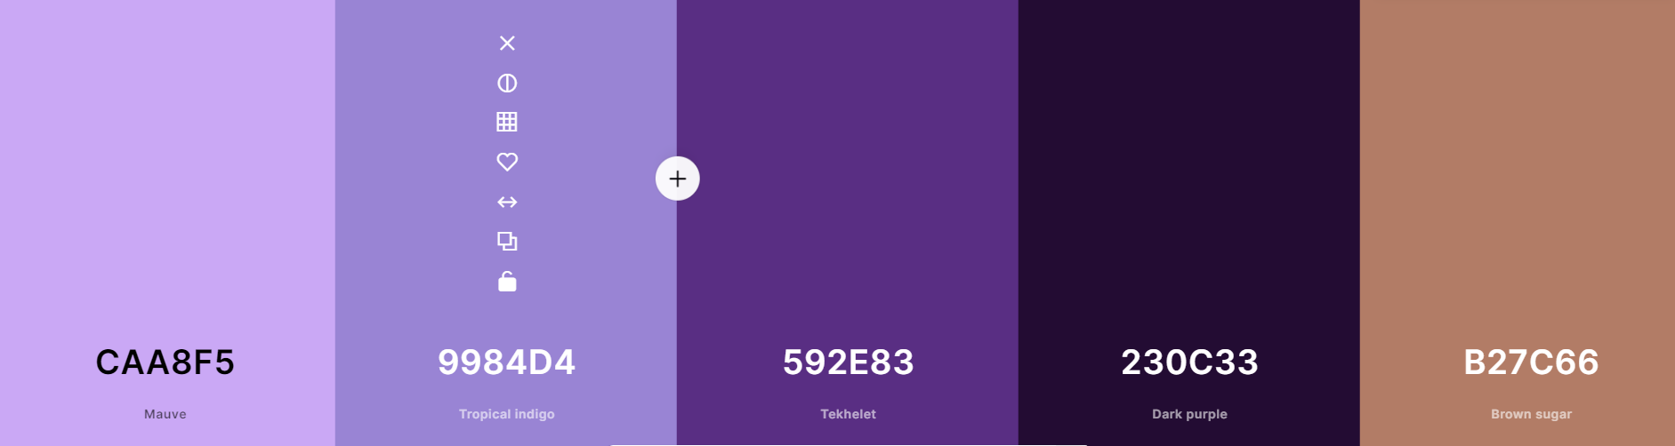
Colour palette generator
Notes:
We all thought on how we were collectively going to agree on a set colour scheme but this was quickly solved with a colour scheme generator which allowed us to mix and match different colours together and efficiently agree on a set colour theme which we carried across the whole site.

